Slide 1
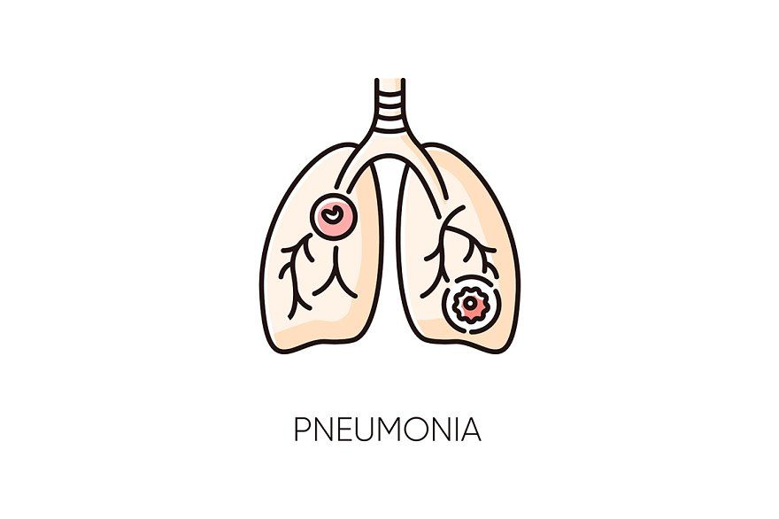
Pneumonia Detection

Slide 2
Overview
This project focuses on the early detection of pneumonia, a critical healthcare concern
I utilized a dataset of chest X-ray images to develop a machine learning model for pneumonia detection

Slide 3
Business and Data Understanding
Stakeholder Audience
The primary stakeholders include healthcare professionals, radiologists, and medical institutions
I selected the Chest X-ray dataset due to its relevance and potential to improve pneumonia diagnosis

Slide 4
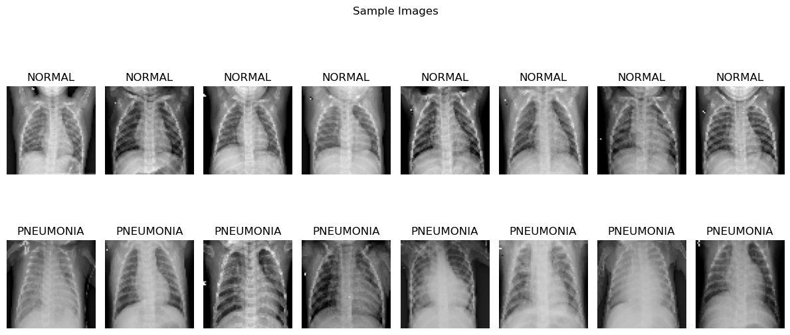

Slide 5
Modeling
I made a model employs a Convolutional Neural Network (CNN) with multiple convolutional and pooling layers for accurate image classification

Slide 6
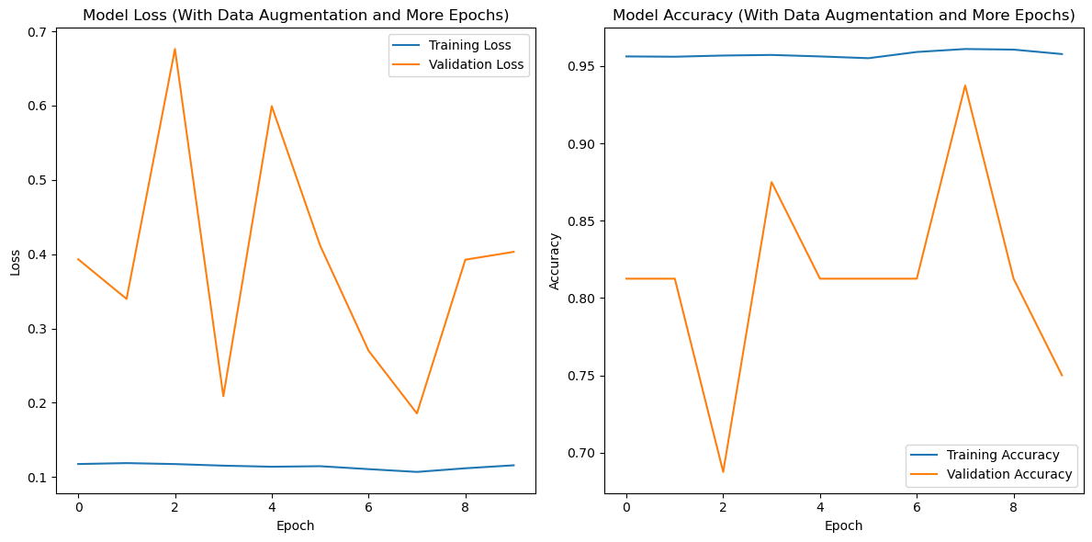
Training Session
To enhance model performance and generalization, I applied data augmentation techniques such as rotation, width shift, height shift, shear, zoom, and horizontal flip to diversify the training dataset
Benefits of Data Augmentation
Data augmentation significantly contributed to reducing overfitting and enhancing the model's generalization capability.

Slide 7
Evaluation
Model Performance Metrics
I assessed the model using key metrics to ensure its reliability and effectiveness."
Detailed Evaluation Metrics
Test Accuracy: The model achieved an impressive test accuracy of 90.38%, indicating its ability to correctly classify pneumonia cases."

Slide 8
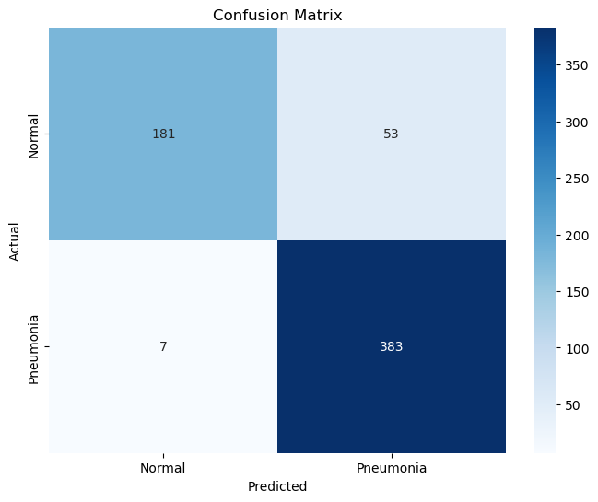
Confusion Matrix
I examined the confusion matrix, which showed that the model achieved a good balance between true positives and true negatives.

Slide 9
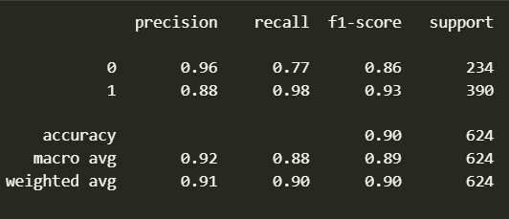
Classification Report
Precision, recall, and F1-score were computed, with the model achieving high values, particularly for pneumonia cases (Class 1).

Slide 10
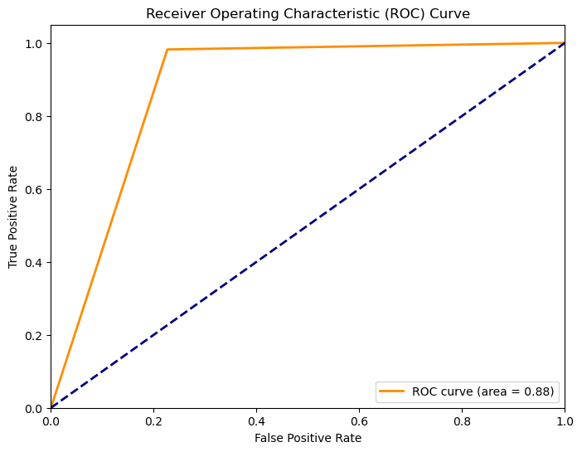
ROC Curve
The Receiver Operating Characteristic (ROC) curve demonstrated the model's strong discrimination ability with an AUC-ROC of 0.88."

Slide 11
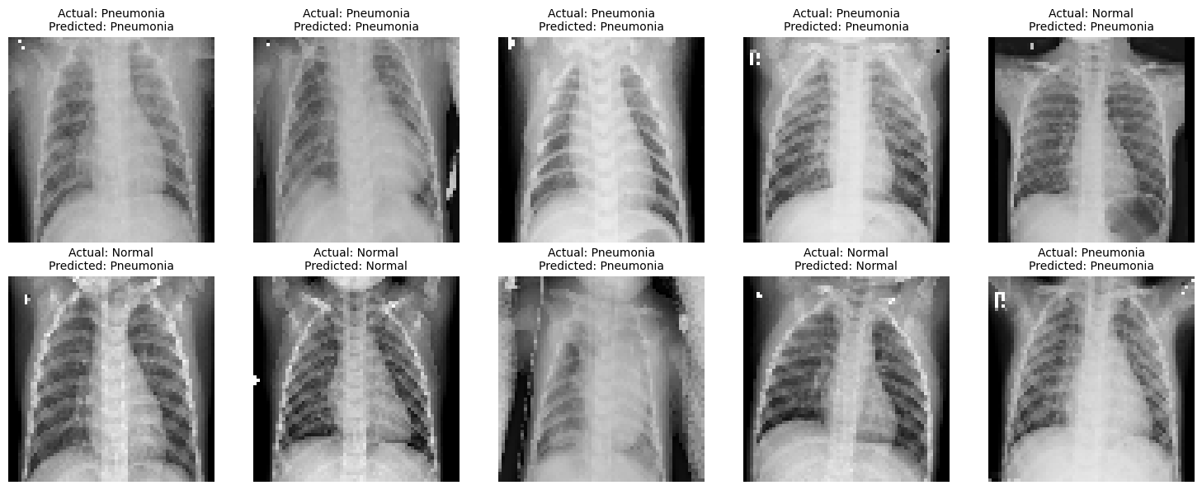
Key Findings
The model demonstrated impressive performance with a test accuracy of 90.38%

Slide 12
Recommendations
Clinical Validation I would recommend collaborating with medical professionals to conduct clinical validation using real patient data to ensure the model's accuracy in a clinical setting.
Ethical Considerations Maintain strict data privacy and fairness in predictions to adhere to ethical guidelines."
User-Friendly Interface Develop an intuitive and user-friendly interface that enables healthcare professionals to interact seamlessly with the model."
Regulatory Compliance Ensure full compliance with healthcare regulations and legal requirements when deploying the model in a clinical environment."
Collaboration Encourage continuous collaboration between data scientists and medical experts to fine-tune the model according to clinical standards."

Slide 13
Next Steps
Future Enhancements
Future enhancements may include further fine-tuning the model architecture and expanding the dataset to improve performance."
Deployment
Outline the deployment process, including steps to integrate the model into clinical workflows.

Slide 14
Thank You
thank you for your time and attention

